Slide 1
SIT saturation periods posted on Caltech web pages:
(file: SIT_release_notes.txt)
=============================================================================
posted 6/23/2015:
2012-149 00:00 (May 28) - 2012-149 12:00 (May 28) SIT-A out of
calibration due high intensity levels saturating MCP response
=============================================================================
posted 6/23/2015:
2012-205 05:00 (Jul 23) - 2012-206 06:00 (Jul 24) SIT-A out of
calibration due high intensity levels saturating MCP response
=============================================================================
posted 6/23/2015:
2013-234 01:00 (Aug 22) - 2012-235 02:00 (Aug 23) SIT-A out of
calibration due high intensity levels saturating MCP response
=============================================================================
posted 6/23/2015:
2014-244 00:00 (Sep 1) - 2014-246 02:00 (Sep 3) SIT-B out of
calibration due high intensity levels saturating MCP response

Slide 2
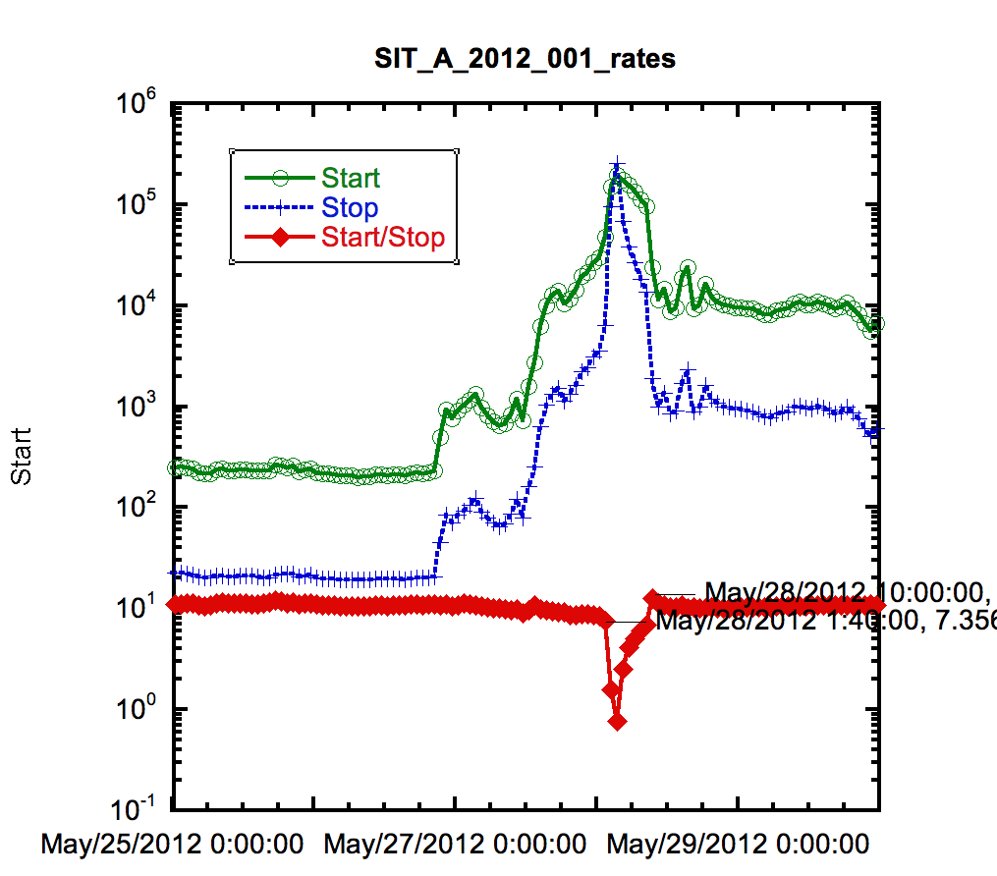

Slide 3
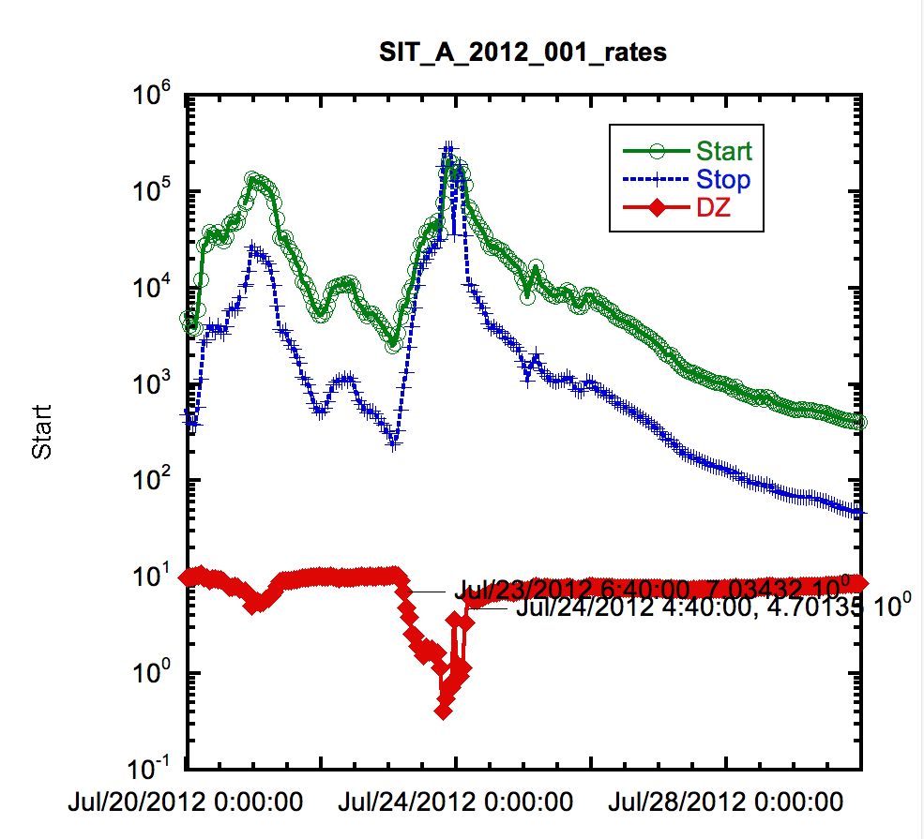

Slide 4
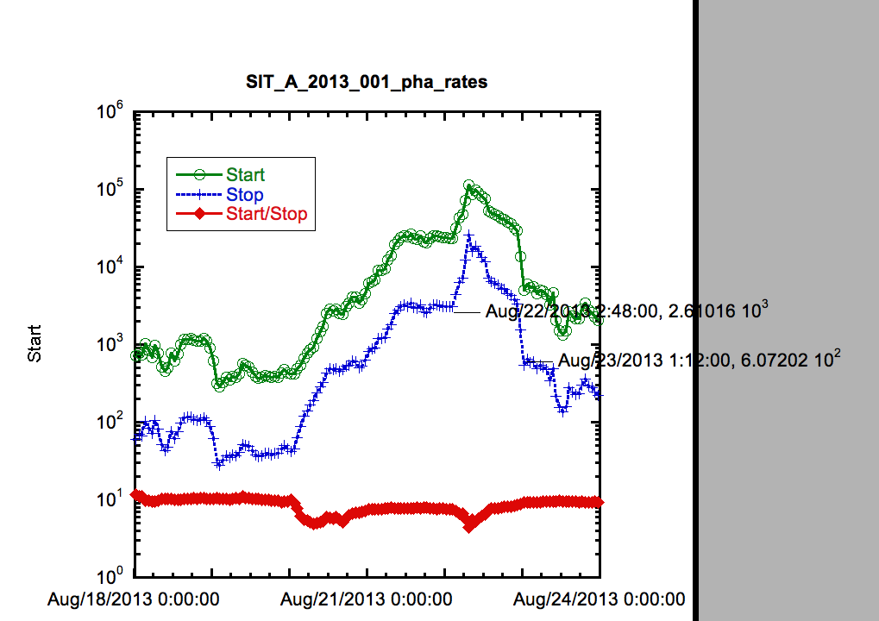
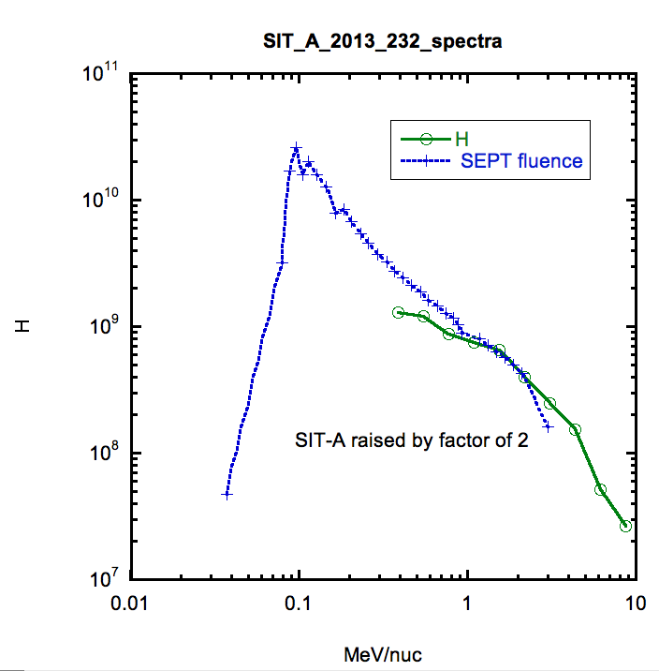
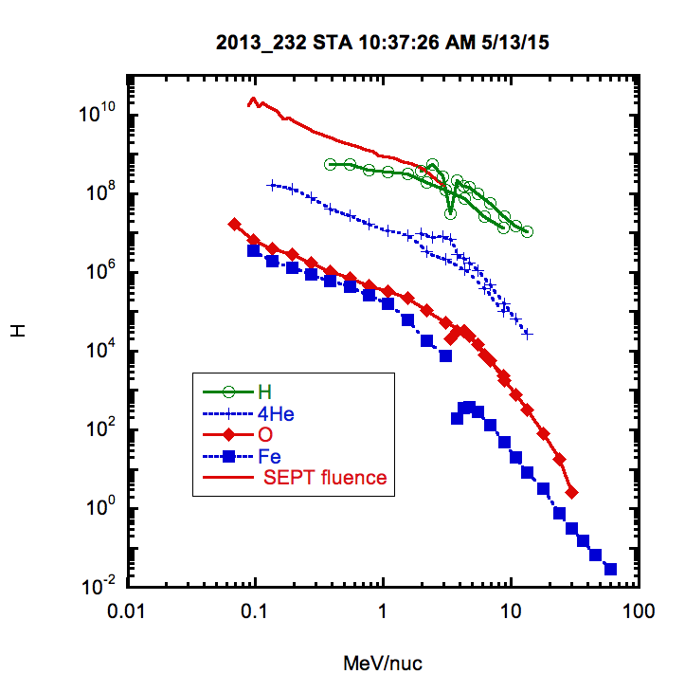

Slide 5
